Slide 1

Pizza Learning:
Random Acts of Pizza
Ricardo Barrera, Yang Linfang
Denis Vrdoljak, Max Yan

Slide 2
Overview
Users request a pizza, and provide a short text of their request.
aka: Random Act of Pizza, or RAOP
Other users, if they feel so inclined, accept the RAOP and buy/send the requester a pizza (positive outcome).
If no user responds to the RAOP, the user doesn’t get a pizza (negative outcome).
The majority of cases result in a negative outcome.
Various meta data is logged and is part of the initial dataset.

Slide 3
Example Entry
{ "giver_username_if_known": "N/A", "in_test_set": false, "number_of_downvotes_of_request_at_retrieval": 2, "number_of_upvotes_of_request_at_retrieval": 6, "post_was_edited": false, "request_id": "t3_w5491", "request_number_of_comments_at_retrieval": 7, "request_text": "I'm not in College, or a starving artist or anything like that. …
"requester_account_age_in_days_at_request": 14.416875, "requester_account_age_in_days_at_retrieval": 531.9697222222222, "requester_days_since_first_post_on_raop_at_request": 0.0, "requester_days_since_first_post_on_raop_at_retrieval": 517.5111805555556, "requester_number_of_comments_at_request": 8, "requester_number_of_comments_at_retrieval": 93, "requester_number_of_comments_in_raop_at_request": 0, "requester_number_of_comments_in_raop_at_retrieval": 4, "requester_number_of_posts_at_request": 1, "requester_number_of_posts_at_retrieval": 6, "requester_number_of_posts_on_raop_at_request": 0, "requester_number_of_posts_on_raop_at_retrieval": 2, "requester_number_of_subreddits_at_request": 8, "requester_received_pizza": true,
"requester_subreddits_at_request": [ "AdviceAnimals", "WTF", "funny", "gaming", "movies", "technology", "todayilearned", "videos" ], "requester_upvotes_minus_downvotes_at_request": 32, "requester_upvotes_minus_downvotes_at_retrieval": 212, "requester_upvotes_plus_downvotes_at_request": 48, "requester_upvotes_plus_downvotes_at_retrieval": 610, "requester_user_flair": "shroom", "requester_username": "RitalinYourMemory", "unix_timestamp_of_request": 1341604684.0, "unix_timestamp_of_request_utc": 1341601084.0
}

Slide 4
Plan and Reality
Failure Analysis
Feature Engineering
Bi-grams/tri-grams
L1/L2 pruning of n-grams
Cluster analysis (maybe)
Combine features we can expect to be non-independent together
Model Selection
Naive Bayes
Logistic Regression
2d - <Other Ideas Here>
Model Optimization
Prune/Filter Noisy Features
Find Optimal Parameters
Build Final Model
Model Testing
Run Model on Test Data
Score Model
Compare to Other Possible Models, Contrast Scores

Slide 5
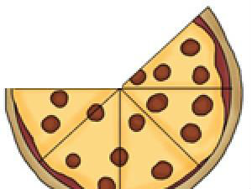
63%
request_text_edit_aware: request_text field after stripping out edits
Tokenized into 2200 features
Resulted in 63% accuracy
Baseline Accuracy

Slide 6
Feature Engineering
Tokenized Title Text
Tokenized Entry Text
Length of Text
Length of Title
requester_number_of_posts_on_raop_at_request
requester_number_of_subreddits_at_request
requester_subreddits_at_request

Slide 7
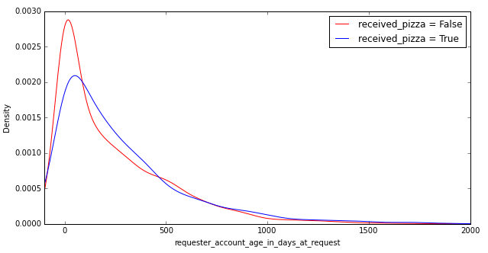
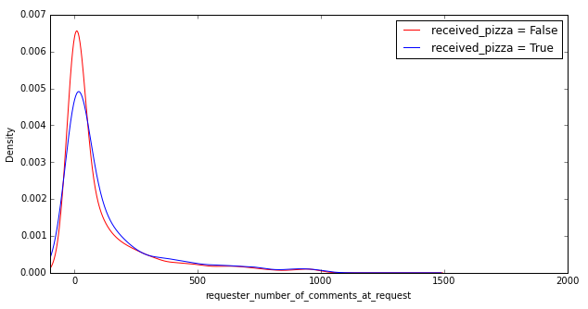
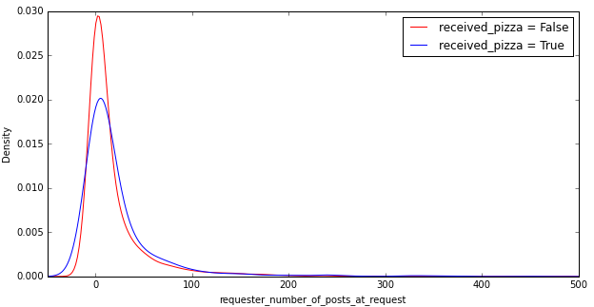
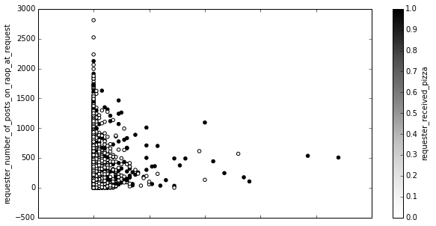
Feature Explorations
hour_of_request
requester_upvotes_minus_downvotes_at_request
day_of_week
day_of_month
...

Slide 8
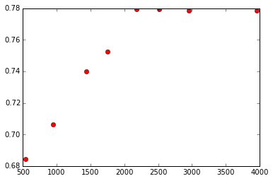
Feature Engineering - Analysis Example
Effect on accuracy of including the tokenized features from the Request Title, at varying vocabulary sizes

Slide 9
Tokenization (including L1/L2 Pruning)
[Max]: These are slides that I feel like we should have, as they led to the biggest performance improvement for our study. That said, feel free to remove them.

Slide 10
Preprocessing
[Max]: These are slides that I feel like we should have, as they led to the biggest performance improvement for our study. That said, feel free to remove them.

Slide 11
Subreddits
[Max]: These are slides that I feel like we should have, as they led to the biggest performance improvement for our study. That said, feel free to remove them.

Slide 12
Failure Analysis
Many False Negatives, Few False Positives
Biased Number of Samples per Class -> Biased Model/Weights

Slide 13
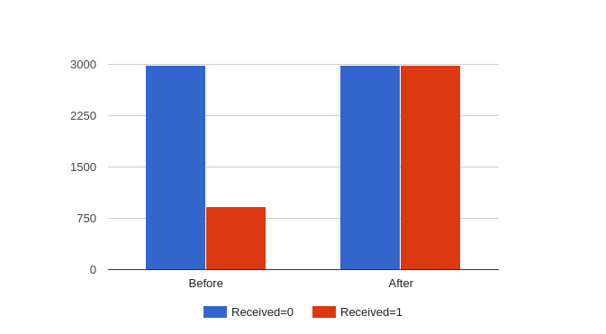
Upsampling vs. Downsampling
24% of positive requests
Under-representation of positive cases
Also tried downsampling negative cases but no clear difference

Slide 14
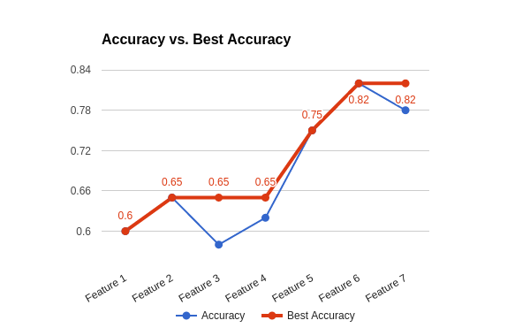
Iterative Feature Selection
A module to evaluate numerical features sequentially
Accepts new feature if it improves test accuracy
Keep only existing features if otherwise

Slide 15
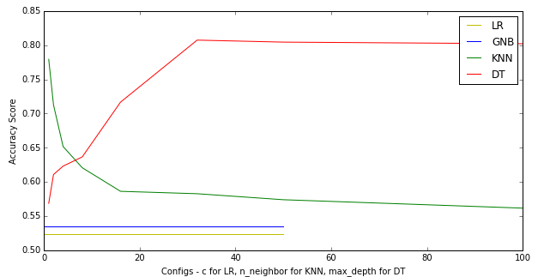
Model Selection
LR, GNB (BNB), KNN, DT
Iterate through a wide range of configs
Include the feature if improves test accuracy
Also select the best model and config

Slide 16
Two Types of Model Ensembling
Text
Title
Subreddits
Numerical
Text
Title
Subreddits
Numerical
Best Model
Best Model
Best Model
Best Model
Best Model
Best Model
Best Model
Best Model
Best Model
Best Model
Best Model
Best Model
Best Model
Best Model
Best Model
Best Model
Prob.
Prob.
Prob.
Prob.
Prob.
Prob.
Prob.
Prob.
Prob.
Prob.
Prob.
Prob.
Prob.
Prob.
Prob.
Prob.
Ensemble Layer
Ensemble Layer
Final Predictions
Final Predictions

Slide 17
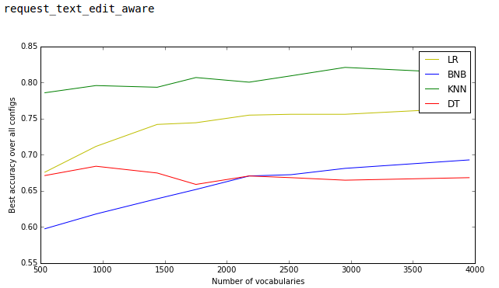
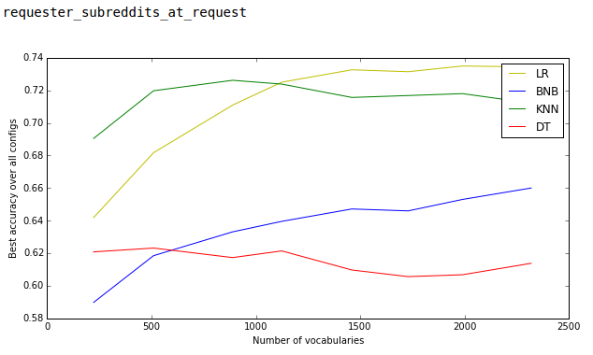
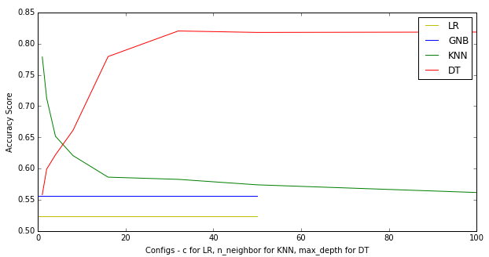



Example Ensembling

Slide 18
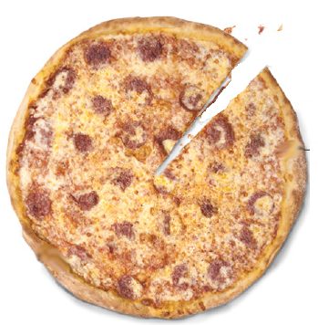
93%
L1 Pruning for tokenized text / title / subreddits
Upsampling of positive cases
Iteratively evaluate and select features
Fit features individually and ensemble the predictions
Final Accuracy

Slide 19
Lessons Learned
GitHub sucks for PYNB co-authoring!
Good coordination prevents integration errors.
Translation to Industry Lesson: Having the coders of key pieces on hand makes a HUGE difference in resolving bugs (vs. having separate integration teams).
I was not able to get through this project without having pizza!

Slide 20
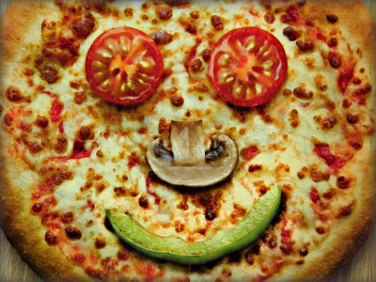

Questions?

